Slide 1
Limits Session 1-3
Course : MATH 6031 – Calculus
Year : 2021

Slide 2
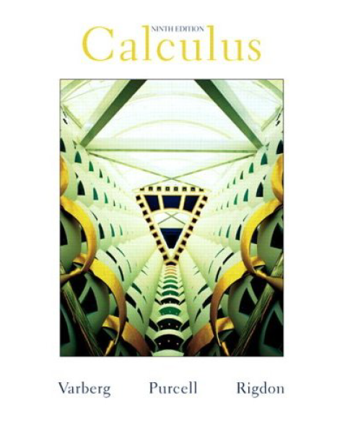
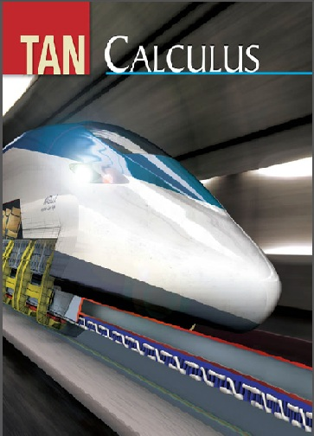
These slides have been adapted from: Dale Varberg, Edwin Purcell, Steve Rigdon. 2007. Calculus. Prentice Hall. ISBN: 978-0132306331. Soo.T.Tan. Calculus. 2010. Brooks/Cole. ISBN-13: 978-0-534-46579-7
Acknowledgement

Slide 3

Learning Objectives
LO 1:
Define the properties of limit to describe geometric and physical problems, and other applications.

Slide 4
Content
1
Introduction to Limits
2
Limit Theorem
3
Limits Involving Trigonometric Functions
4
Limits at infinity
5
Continuity

Slide 5
Problems Leading to the Limit Concept
Area
The areas of rectangles and triangles calculated by formulas
Archimedes Idea
Archimedes had this idea. Imagine regular polygons inscribed
Limit
The area of the circle is the limit of the areas of the inscribed
from geometry
in a circle. He was able to find the area of a regular polygon
with n sides, and by taking the regular polygon with more
and more sides, he was able to approximate the area of a
circle to any desired level of accuracy.
polygons as n (the number of sides in the polygon) increases
without bound.

Slide 6
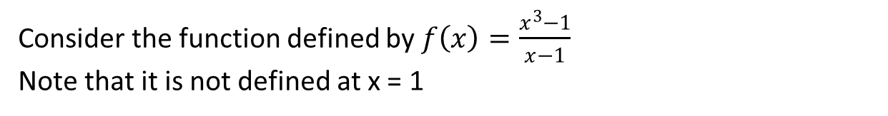
An Intuitive Understanding
Consider the function defined by $f\left(x\right)=\frac{x^{3}−1}{x−1}$
Note that it is not defined at x = 1

Slide 7
Intuitive Meaning of a Limit
Definition
Limit
To say that $\lim_{x→c}{f\left(x\right)}=L$, means that when x is near but
To say that lim┬(𝑥→𝑐)⁡𝑓(𝑥)=𝐿, means that when x is near but
Right- and Left-Hand Limits
To say that $\lim_{x→c^{+}}{f\left(x\right)}=L$, means that when x is near but to the right of c then f(x) is near L
To say that lim┬(𝑥→𝑐^+ )⁡𝑓(𝑥)=𝐿, means that when x is near but to the right of c then f(x) is near L
Definition
To say that $\lim_{x→c^{−}}{f\left(x\right)}=L$, means that when x is near but to the left of c then f(x) is near L
To say that lim┬(𝑥→𝑐^− )⁡𝑓(𝑥)=𝐿, means that when x is near but to the left of c then f(x) is near L
different from c then f(x) is near L

Slide 8
Limit Theorem
Theorem
$\lim_{x→c}{f\left(x\right)}=L$ if and only if $\lim_{x→c^{+}}{f\left(x\right)}=L$ and $\lim_{x→c^{−}}{f\left(x\right)}=L$
lim┬(𝑥→𝑐)⁡𝑓(𝑥)=𝐿 if and only if lim┬(𝑥→𝑐^+ )⁡𝑓(𝑥)=𝐿 and lim┬(𝑥→𝑐^− )⁡𝑓(𝑥)=𝐿

Slide 9
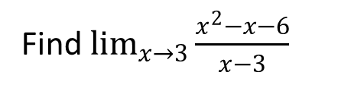
Example 1
Note that $\frac{x^{2}−x−6}{x−3}$
is not defined at x = 3 but this is all right.
Note that (𝑥^2−𝑥−6)/(𝑥−3)
is not defined at x = 3 but this is all right.
what is happening as x approaches 3, we could use a calculator to evaluate the given expression, for example, at 3.1, 3.01, 3.001, and so on.
it is much better to use a little algebra to simplify the problem.
$$\lim_{x→3}{\frac{x^{2}−x−6}{x−3}}$$
$$=\lim_{x→3}\frac{\left(x−3\right)\left(x+2\right)}{x−3}=\lim_{x→3}\left(x−2\right)=3+2=5$$
it is much better to use a little algebra to simplify the problem.
lim┬(𝑥→3)⁡〖(𝑥^2−𝑥−6)/(𝑥−3)〗
=lim┬(𝑥→3) (𝑥−3)(𝑥+2)/(𝑥−3)=lim┬(𝑥→3) (𝑥−2)=3+2=5
Find $\lim_{x→3}{\frac{x^{2}−x−6}{x−3}}$

Slide 10
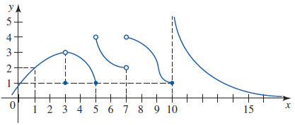
Example 2
Use the graph of the function shown in Figure to find the given limit, if it exists.

Slide 11
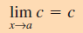

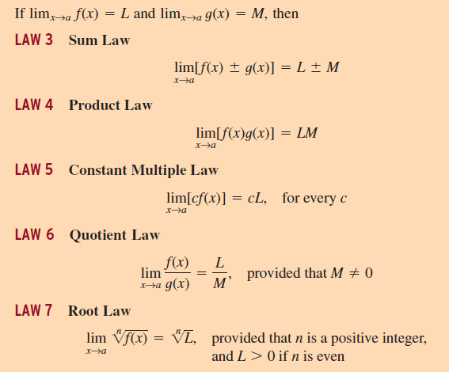
Limit Laws

Slide 12
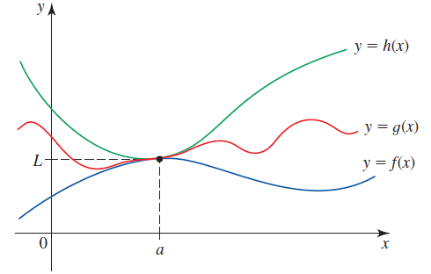


The Squeeze Theorem
1
Suppose that f(x) ≤ g(x) ≤ h(x) for all x in an open interval containing a, except possibly at a, and
$$\lim_{x→a}{f\left(x\right)}=L=\lim_{x→a}{h\left(x\right)}$$
Then
$$\lim_{x→a}{g\left(x\right)}=L$$
2
3

Slide 13
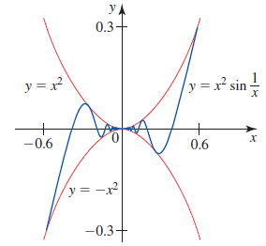


Example 3
1
2
Lets find
Remember -1 ≤ sin t ≤ 1 for every real number t, so that
$$−1≤\sin{\frac{1}{x}}≤1,$$
$$−x^{2}≤\sin{\frac{1}{x}}≤x^{2}$$
The Squeeze Theorem implies
that
We know that
$$\lim_{x→0}{x^{2}}\sin{\frac{1}{x}}=0$$
4
3

Slide 14
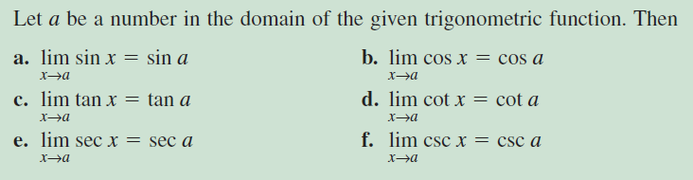


Limits of Trigonometric Functions

Slide 15


Example 4

Slide 16
Example 5: Limits at Infinity
1
The graph of
$$f\left(x\right)=\frac{2x^{3}}{1+x^{3}}$$
is shown in Figure.
The graph of
𝑓(𝑥)=(2𝑥^3)/(1+𝑥^3 )
is shown in Figure.
2
To find the limit, divide both the numerator and denominator by $x^{3}$
To find the limit, divide both the numerator and denominator by 𝑥^3
$$\lim_{x→∞}{\frac{2x^{3}}{1+x^{3}}}=\lim_{x→∞}\frac{2}{\frac{1}{x^{3}}+1}$$
$$=\frac{2}{0+1}=2$$
lim_(𝑥→∞)⁡〖(2𝑥^3)/(1+𝑥^3 )〗=lim┬(𝑥→∞) 2/(1/𝑥^3 +1)
=2/(0+1)=2

Slide 17
Example 6: Infinite Limits
Left Limit
Right Limit
Limit
$$\lim_{x→1^{−}}{\frac{1}{{\left(x−1\right)}^{2}}}=∞$$
lim_(𝑥→1^− )⁡〖1/(𝑥−1)^2 〗=∞
$$\lim_{x→1^{+}}{\frac{1}{{\left(x−1\right)}^{2}}}=∞$$
lim┬(𝑥→1^+ )⁡〖1/(𝑥−1)^2 〗=∞
$$\lim_{x→1}{\frac{1}{{\left(x−1\right)}^{2}}}=∞$$
lim┬(𝑥→1)⁡〖1/(𝑥−1)^2 〗=∞

Slide 18






Relation to Asymptotes
A Vertical Asymptote
A Horizontal Asymptote
The line x = c is a vertical asymptote of the graph of y = f(x) if any of the following four statements is true.
The line y = b is a horizontal asymptote of the graph of y = f(x) if either
$$\lim_{x→c^{+}}{f(x)}=∞$$
$$\lim_{x→∞}{f(x)}=b$$
$$\lim_{x→c^{+}}{f(x)}=−∞$$
$$\lim_{x→−∞}{f(x)}=b$$
$$\lim_{x→c^{−}}{f(x)}=∞$$
$$\lim_{x→c^{−}}{f(x)}=−∞$$

Slide 19
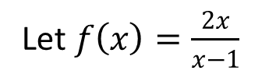


Example 7
A vertical asymptote at a point where the denominator is zero, In this case:
$\lim_{x→1^{+}}{\frac{2x}{x−1}}=∞$ $\lim_{x→1^{−}}{\frac{2x}{x−1}}=−∞$
On the other hand,
and so y = 2 is a horizontal asymptote.
$\lim_{x→∞}{\frac{2x}{x−1}}=2$ $\lim_{x→−∞}{\frac{2x}{x−1}}=2$
Let $f\left(x\right)=\frac{2x}{x−1}$

Slide 20

Continuity at a Point
Definition Continuity at a Point
Let f be defined on an open interval containing c. We say that f is continuous at c if
$$\lim_{x→c}{f\left(x\right)}=f(c)$$
$\lim_{x→c}{f\left(x\right)}$ does not exist
lim┬(𝑥→𝑐)⁡𝑓(𝑥) does not exist
$$\lim_{x→c}{f\left(x\right)}≠f(c)$$
lim┬(𝑥→𝑐)⁡𝑓(𝑥)≠𝑓(𝑐)
$$\lim_{x→c}{f\left(x\right)}=f(c)$$
lim┬(𝑥→𝑐)⁡𝑓(𝑥)=𝑓(𝑐)

Slide 21
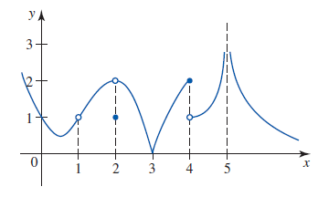
Example 8
Based on the graph:
The function f is continuous at 0 because
It is discontinuous at 1 because f(1) is not defined.
It is discontinuous at 2 because
It is continuous at 3 because
It is discontinuous at 4 and 5 because and
does not exist.

Slide 22
Continuity on an Interval
A function f is continuous on an open interval (a,b) if it is continuous at every number in the interval.
function f is continuous on a closed interval [a,b] if it is continuous on (a,b) and is also continuous from the right at a and from the left at b.
A function f is continuous on a half-open interval [a,b) or (a,b] if f is continuous on (a,b) and f is continuous from the right at a or f is continuous from the left at b, respectively

Slide 23
Other Continuity Theorem
Theorem
Continuity of Polynomial and Rational Functions
a. A polynomial function is continuous on (-∞, ∞).
b. A rational function is continuous on its domain.
Continuity of Trigonometric Functions
The functions sin x, cos x, tan x, csc x, sec x, and cot x are continuous at every number in their respective domain.

Slide 24
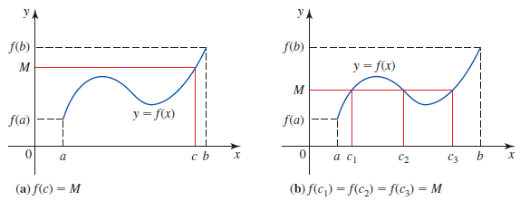
The Intermediate Value Theorem
If f is a continuous function on a closed interval [a,b] and M is any number between f(a) and f(b), inclusive, then there is at least one number c in [a,b] such that f(c) = M.

Slide 25
Dale Varberg, Edwin Purcell, Steve Rigdon. 2007. Calculus. Prentice Hall. ISBN: 978-0132306331.
Dale Varberg, Edwin Purcell, Steve Rigdon. 2014. Calculus Early Transcendentals. Pearson New International Edition. ISBN: 978-1-292-04268-8
Soo.T.Tan. 2010. Calculus. Brooks/Cole. ISBN-13: 978-0-534-46579-7

